Slide 1

Routing and Routers

Slide 2
Routing and Routers
Router Basics
Router Startup procedure
Routing
Router configuration
RIPv1/RIPv2

Slide 3

Router Basics

Slide 4
Internal Components
RAM
NVRAM
Flash
ROM
Console
Interfaces
Auxiliary

Slide 5
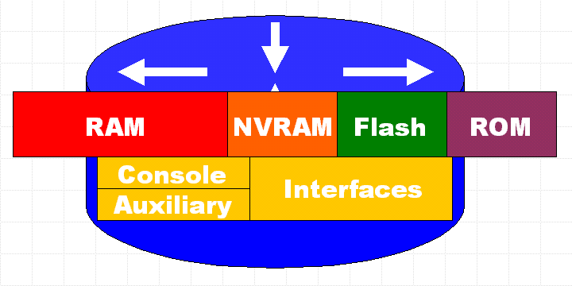
RAM
Temporary storage for router configuration files
RAM content is lost on power down or restart
Stores...
Routing tables
ARP cache
Fast switching cache
Packet buffering
Packet hold queues

Slide 6
NVRAM
Non-volatile RAM
Stores backup/startup configuration files
Content is not lost when router is powered down or restarted.

Slide 7
Flash
EEPROM (Electronically Erasable Programmable Read-Only Memory)
Holds the Cisco IOS (Internet Operating System)
Allows updating of software without replacing the Flash chip
Multiple versions of IOS can be stored
Retained on power down

Slide 8
ROM
Contains POST (Power On Self Test)
A bootstrap program (loads the Cisco IOS)
And operating system software
Backup, trimmed down version of the IOS
Upgrades require installing new chip set

Slide 9
Interfaces
Network connections through which packets enter and exit the router
Attached to the motherboard or as separate modules.

Slide 10
Router Startup Procedure

Slide 11
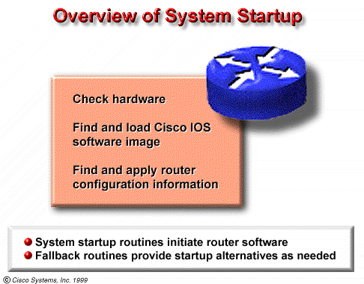
System Startup Procedure
1. Perform a power-up self test(POST):During this self test, the router executes diagnostics from ROM on all hardware modules.
2. Verify the basic operation of CPU, memory, and network interface ports.
3. Software initialization.

Slide 12
Software Startup Procedure
Step 1 - The generic bootstrap loader, in ROM, executes on the CPU card.
Step 2 - The operating system (Cisco IOS) can be found in one of several places. The location is disclosed in the boot field of the configuration register.
Step 3 - The operating system image is loaded.
Step 4 - The configuration file saved in NVRAM is loaded into main memory and executed one line at a time.
Step 5 - If no valid configuration file in NVRAM, then executes a question-driven initial configuration routine referred to as the system configuration dialog, also called the setup mode.

Slide 13
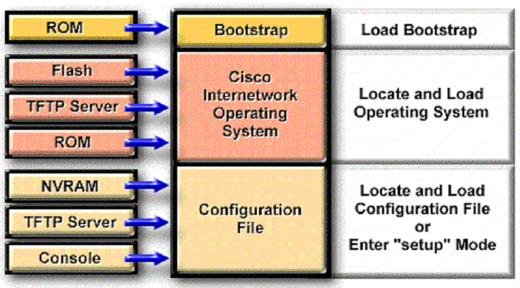
Router Startup Procedure
Setup is not intended as the mode for entering complex protocol features in the router.
You should use setup to bring up a minimal configuration, then use various configuration-mode commands, rather than setup, for most router configuration tasks

Slide 14
Routing

Slide 15
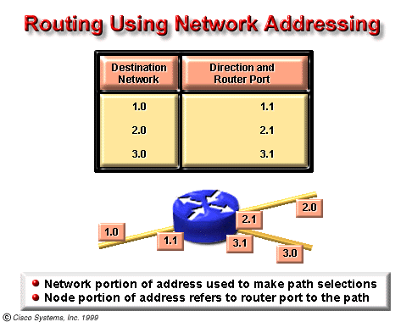
A router generally relays a packet from one data link to another, using two basic functions, a path determination function and a switching function.
The switching function allows a router to accept a packet on one interface and forward it through a second interface.
The path determination function enables the router to select the most appropriate interface for forwarding a packet.
The router uses the network portion of the address to make path selections to pass the packet to the next router
The node portion of the address is used by the the router directly connected to the destination network to deliver the packet to the correct host.

Slide 16
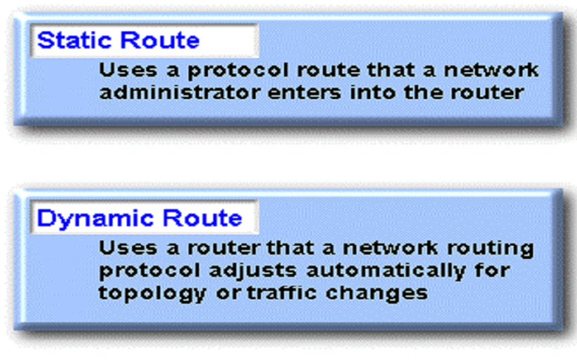
Static and Dynamic Route

Slide 17
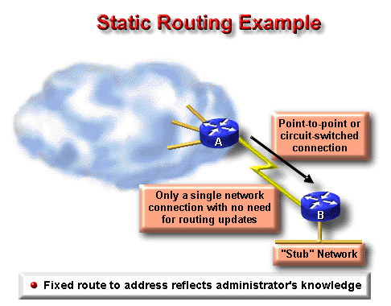
Static and Dynamic Route
Whereas dynamic routing tends to reveal everything known about an internetwork, for security reasons, you may want to hide parts of an internetwork.
When a network is accessible by only one path, a static route to the network can be sufficient.
This type of partition is called a stub network.

Slide 18
Static Route Configuration
A static route allows manual configuration of the routing table.
ip route Command
Description
network
destination network or subnet
mask
subnet mask
address
IP address of the next-hop router
interface
the interface to use to get to the destination network
distance
administrative distance

Slide 19
Administrative Distance
The administrative distance is a rating of the trustworthiness of a routing information source, expressed as a numeric value from 0 to 255.
The higher the number, the lower the trustworthiness rating.
So the administrative distance of static routes is often low.(1 is the default)

Slide 20
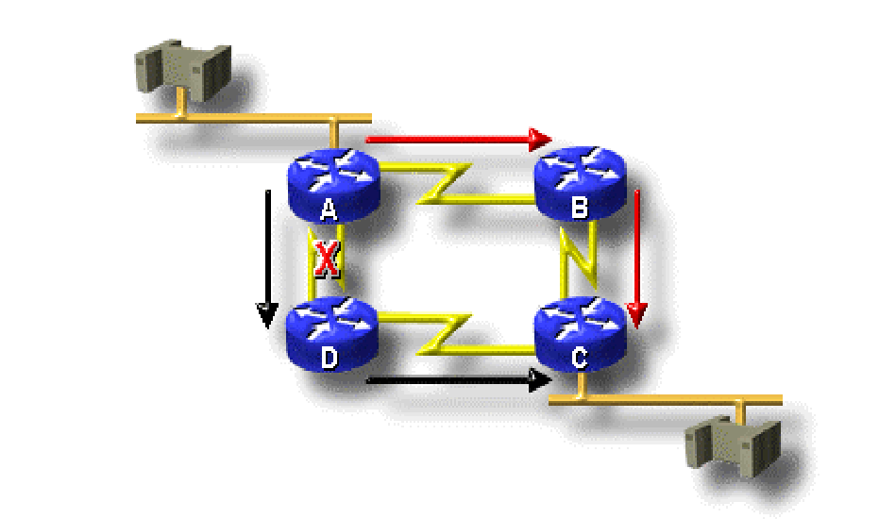
Dynamic Routing
Dynamic routing protocols can also redirect traffic (or loadshare) between different paths in a network
.

Slide 21
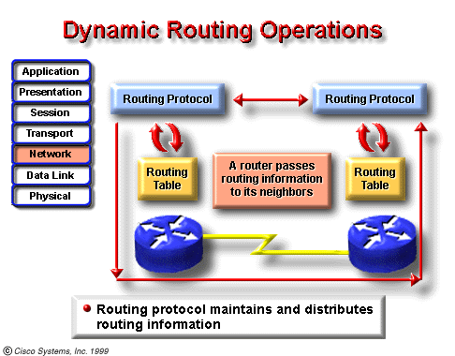
Dynamic routing
Dynamic routing relies on a routing protocol to share knowledge among routers.
The dynamic routing depends on two basic router functions:
maintenance of a routing table
distribution of knowledge to other routers

Slide 22
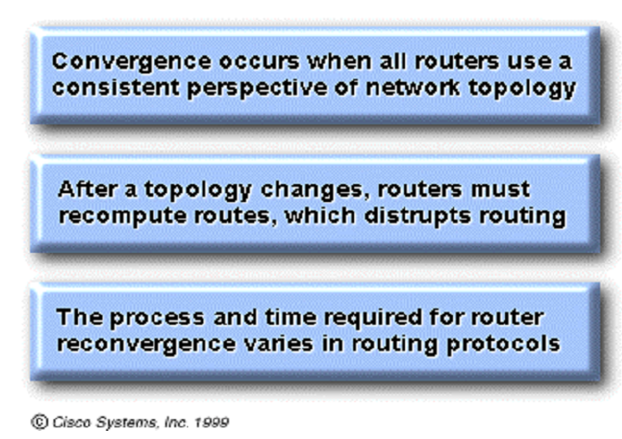
Time to Convergence

Slide 23
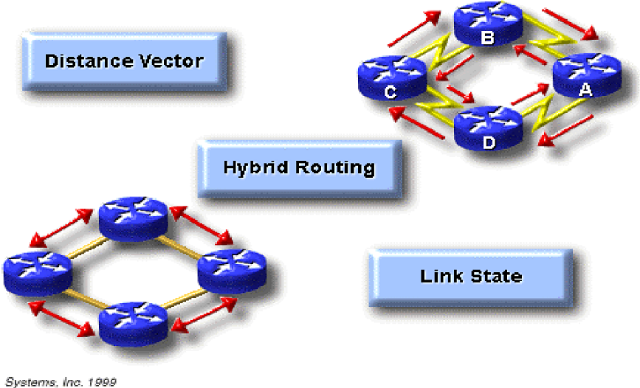
Classification of Routing Protocols

Slide 24
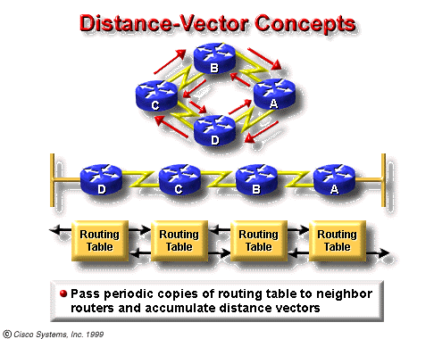
Distance-Vector Protocol
Distance-vector algorithms do not allow a router to know the exact topology of an internetwork
Distance-vector-based routing algorithms (also known as Bellman-Ford algorithms) pass periodic copies of a routing table from router to router.

Slide 25
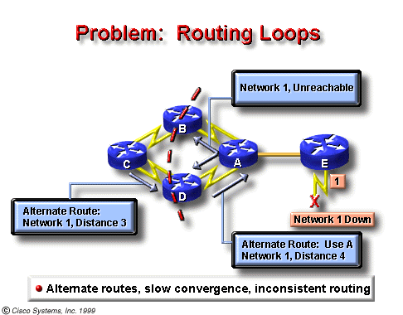
Notes:
路由环路是指数据包在一系列路由器之间不断传输却始终无法到达其预期目的网络的一种现象。当两台或多台路由器的路由信息中存在错误地指向不可达目的网络的有效路径时，就可能发生路由环路。

Slide 26
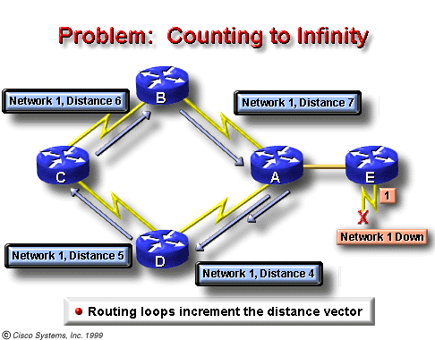
The invalid updates of Network 1 will continue to loop until some other process stops the looping.
This condition, called count to infinity, loops packets continuously around the network in spite of the fundamental fact that the destination network, Network 1, is down.
While the routers are counting to infinity, the invalid information allows a routing loop to exist.
Notes:
环路内的路由器占用链路带宽来反复收发流量。
路由器的 CPU 因不断循环数据包而不堪重负。
路由器的 CPU 承担了无用的数据包转发工作，从而影响到网络收敛。
路由更新可能会丢失或无法得到及时处理。这些状况可能会导致更多的路由环路，使情况进一步恶化。
数据包可能丢失在“黑洞”中。

Slide 27
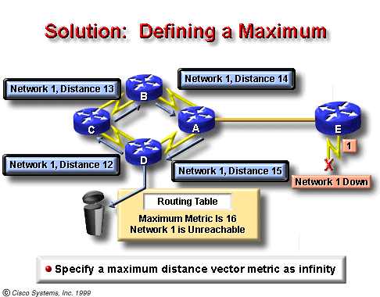
Solution: Defining a Maximum

Slide 28
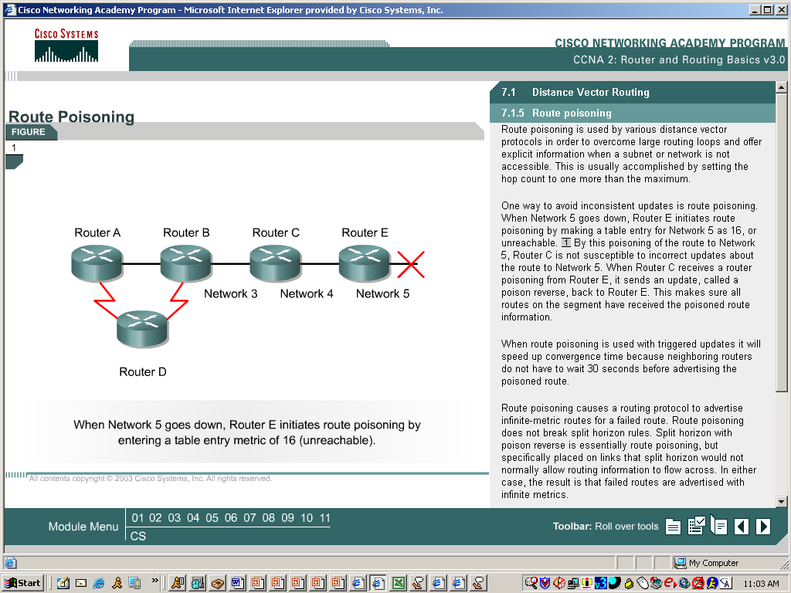
Solution: Route Poisoning
When Network 5 goes down, Router E initiates route poisoning by making a table entry for Network 5 as 16, or unreachable.
When Router C receives a route poisoning from Router E, it sends an update, called a poison reverse, back to Router E. This makes sure all routers on the segment have received the poisoned route information.
Notes:
网络 10.4.0.0 由于链路故障而变得不可用。
R3 通过将度量值设置为 16 使该路由毒化，然后发送触发更新指明 10.4.0.0 不可达。
R2 处理该更新。由于度量为 16，所以 R2 在其路由表中将该路由条目标记为无效。
R2 随后将毒性更新发送给 R1，更新中的度量值被再次设置为 16，以此表明该路由不可用。
R1 处理该更新并将其路由表中的 10.4.0.0 条目标记为无效。

Slide 29
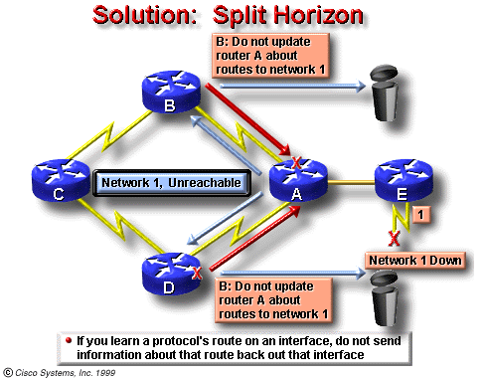
Solution: Split Horizon
Notes:
R2 随后通过 S0/0/0 将 10.4.0.0 网络通告给 R1。R2 不会通过 S0/0/1 将 10.4.0.0 通告给 R3，因为该路由正是从该接口获得。

Slide 30
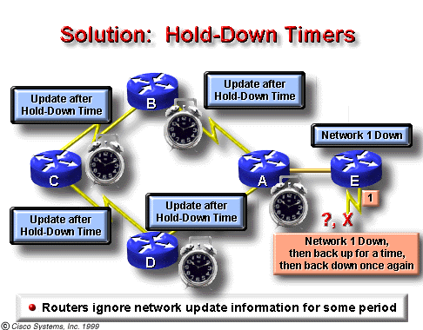
Solution: Hold-Down Timers
Notes:
距离矢量协议采用触发更新来加速收敛过程。请记住，除触发更新外，使用距离矢量路由协议的路由器还会发送定期更新。假设现在存在一个不稳定的网络。在很短的时间内，接口被重置为 up，然后是 down，接着再重置为 up。该路由将发生摆动。使用触发更新时，路由器可能会反应过快，从而在不知情的情况下造成路由环路。此外，路由器在不稳定期间发送的定期更新也可能导致路由环路。抑制计时器可以防止在上述情况中出现路由环路。抑制计时器还有助于防止计数至无穷大情况的出现。
1. 路由器从邻居处接收到更新，该更新表明以前可以访问的网络现在已不可访问。
2. 路由器将该网络标记为 possibly down 并启动抑制计时器。
3. 如果在抑制期间从任何相邻路由器接收到含有更小度量的有关该网络的更新，则恢复该网络并删除抑制计时器。
4. 如果在抑制期间从相邻路由器收到的更新包含的度量与之前相同或更大，则该更新将被忽略。如此一来，更改信息便可以继续在网络中传播一段时间。
5. 路由器仍然会转发目的网络被标记为 possibly down 的数据包。通过这种方式，路由器便能克服连接断续所带来的问题。如果目的网络确实不可达，但路由器又转发了数据包，黑洞路由就会建立起来并持续到抑制计时器超时。

Slide 31
Prevent Sending Route update
To prevent an interface from sending out any route update information,use the command:
Router(config-router)#Passive-interface f0/0
It is valid only when using distance-vector routing protocols, because link-state routing protocols do not get the topology information directly from the routing table of its neighbors

Slide 32
Link-state Protocol
Link-state based routing algorithms also known as SPF (shortest path first) algorithms, maintain a complex database of topology information.
Link-state routing uses:
link-state advertisements(LSAs)
a topological database
the SPF algorithm, and the resulting SPF tree
a routing table of paths and ports to each network
RFC 1583 contains a description of OSPF link-state concepts and operations.

Slide 33
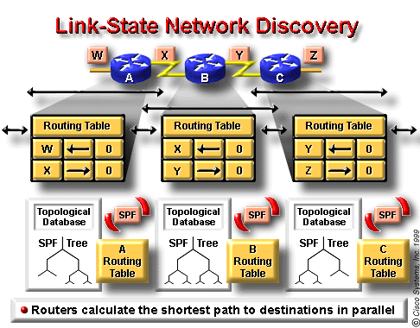
Routers exchange LSAs with each other. Each router begins with directly connected networks
Each router in parallel with the others constructs a topological database consisting of all the LSAs from the internetwork.
The SPF algorithm computes network reachability. The router constructs this logical topology as a tree, with itself as root, consisting of all possible paths to each network in the link-state protocol internetwork. It then sorts these paths shortest path first (SPF).
4. The router lists its best paths, and the ports to these destination networks, in the routing table. It also maintains other databases of topology elements and status details.

Slide 34
Link-state Concerns
There are two link-state concerns:
Processing and memory requirements
Running link-state routing protocols in most situations requires that routers use more memory and perform more processing than distance-vector routing protocols.
Bandwidth requirements
During Initial link-state packet flooding, all routers using link-state routing protocols send LSA packets to all other routers. This action floods the internetwork as routers make their demand for bandwidth, and temporarily reduce the bandwidth available for routed traffic that carries user data.

Slide 35
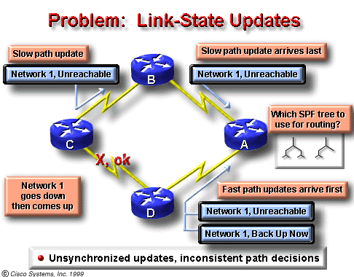
Problem: Link-state Updates
Link-state routing must make sure that all routers get all necessary LSA packets.
Routers with different sets of LSAs calculate routes based on different topological data.

Slide 36
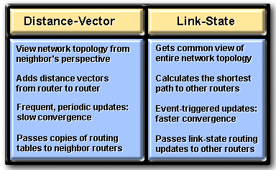
Comparing: Link-state and Distance-Vector

Slide 37
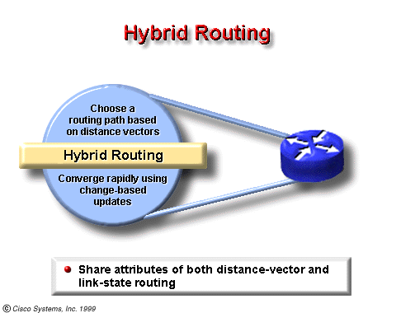
Hybrid Protocols
Examples of hybrid protocols:
OSI’s IS-IS (Intermediate System-to-Intermediate System)
Cisco’s EIGRP (Enhanced Interior Gateway Routing Protocol ).

Slide 38
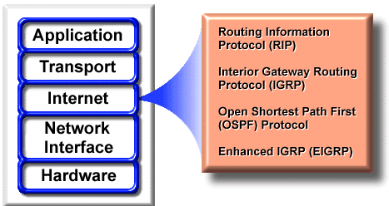
Routing Protocols
Examples of IP routing protocols include:
RIP - a distance-vector routing protocol
IGRP - Cisco’s distance-vector routing protocol
OSPF - a link-state routing protocol
EIGRP - a balanced hybrid routing protocol

Slide 39
Primary Goals of Routing Protocols
Optimal Route—pick the best route
Efficiency—minimal use of bandwidth and router processor resources
Rapid Convergence—the faster, the better. Some are quicker at converging than others.
Flexibility—can handle a wide variety of situations such as high usage and failed routes

Slide 40
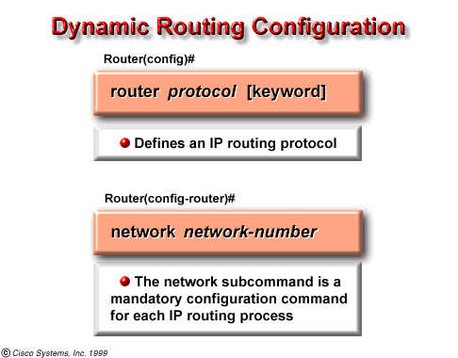
Router Commands
Description
protocol
either RIP, IGRP, OSPF, or Enhanced IGRP.
options
such as autonomous system, which is used with protocols that require it, such as IGRP
Network Command
Description
network-number
specifies a directly-connected network

Slide 41
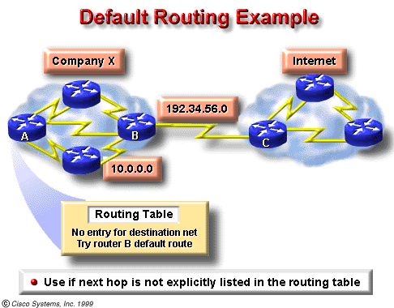
Define Default Route
Default routes keep routing tables shorter.
When an entry for a destination network does not exist in a routing table, the packet is sent to the default network.

Slide 42
Define Default Route(I)
Define a default route using dynamic routing protocols
Router(config)# ip default-network [network-number]
ip default network Command
Description
network-number
IP network number or subnet number defined as the default

Slide 43
Define Default Route(II)
Define a default route as a static route:
Router(config)# ip route 0.0.0.0 0.0.0.0 [next-hop-ip-address| exit-interface]
After configure a default route, use show ip route will display: (172.16.1.2 is the default next-hop address)
Gateway of last resort is 172.16.1.2 to network 0.0.0.0

Slide 44
RIP History
RIP v1 is considered an interior gateway protocol that is classful.
RIP v1 is a distance vector protocol that broadcasts its entire routing table to each neighbor router at predetermined intervals. The default interval is 30 seconds.
RIP uses hop count as a metric, with 15 as the maximum number of hops.
RIP v1 is capable of load balancing over as many as six equal-cost paths, with four paths as the default
RIP was originally specified in RFC 1058

Slide 45
RIP History
RIPv1 has the following limitations:
It does not send subnet mask information in its updates.
It sends updates as broadcasts on 255.255.255.255 .
It does not support authentication.
It is not able to support VLSM or Classless Interdomain Routing (CIDR).

Slide 46
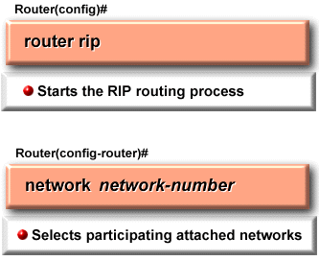
RIP Configuration
The router rip command selects RIP as the routing protocol.
The network command assigns a NIC-based network address to which a router will be directly connected.

Slide 47
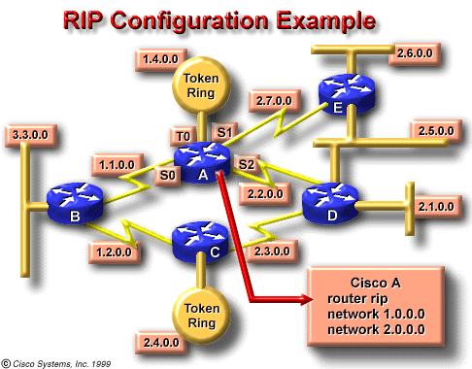
RIP Configuration
router rip
network 1.0.0.0
network 2.0.0.0

Slide 48
RIP v2
RIP v2 is an improved version of RIP v1 and shares the following features:
It is a distance vector protocol that uses a hop count metric.
It uses holddown timers to prevent routing loops – default is 180 seconds.
It uses split horizon to prevent routing loops.
It uses 16 hops as a metric for infinite distance.

Slide 49
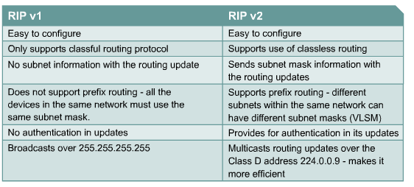
Comparing RIPv1 and RIPv2

Slide 50
RIP v2 Configuration
The router command starts the routing process.
The network command causes the implementation of the following three functions:
The routing updates are multicast out an interface.
The routing updates are processed if they enter that same interface.
The subnet that is directly connected to that interface is advertised.

Slide 51
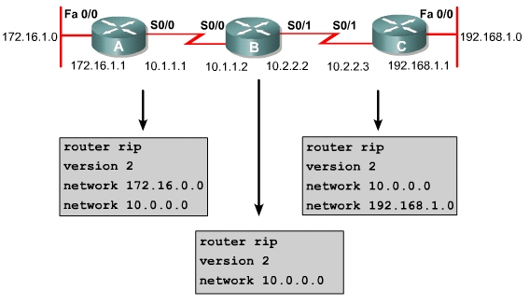
RIP v2 Configuration Example
Select a routing protocol
Select rip version 2 as the routing protocol
Mandatory configuration command for each IP routing process

Slide 52
Verifying &Troubleshooting
Verifying RIP v2
Router# show ip protocols
Verifying the RIP Configuration
Router# show ip route
Displaying the IP Routing Table
Troubleshooting RIP v2
Router# debug ip rip
display RIP routing updates sent and received.
Router# undebug all (/no debug all)
Router# turn off all debugging

Slide 53
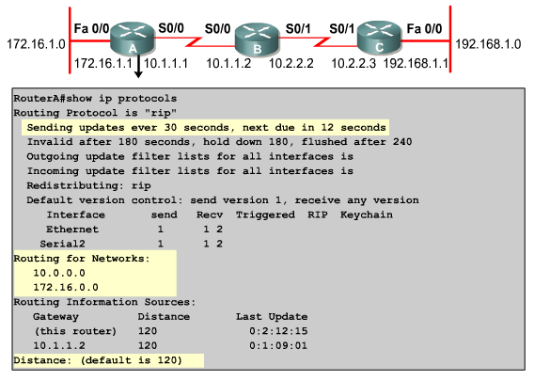
Notes:
图中突出显示的部分是一些计时器，其中显示了该路由器发送下一轮更新的时间 － 在本例中为从现在起 12 秒后。
此部分信息与过滤更新和重分布路由有关（前提是路由器配置有这些功能）。过滤和重分布都将在 CCNP 级别的主题中讨论。
这块输出包含与当前配置的 RIP 版本和参与 RIP 更新的接口相关的信息。
此时会列出使用 network 命令配置的有类网络。R2 会在其 RIP 更新中包含这些网络。

Slide 54
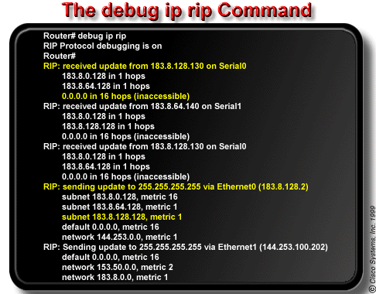
The debug ip rip command displays RIP routing updates as they are sent and received. In this example, the update is sent by 183.8.128.130.
It reported on three routers, one of which is inaccessible because its hop count is greater than 15. Updates were then broadcast through 183.8.128.2.

Slide 55
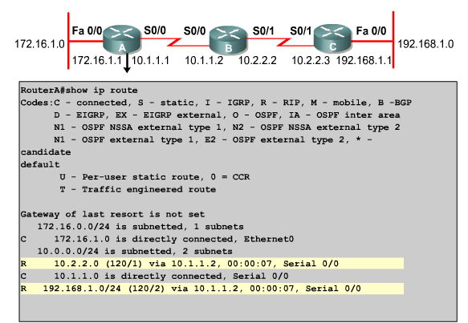
Notes:
. Use the show running-config or show ip protocols privileged EXEC commands on the router to check for a possible misconfigured routing protocol.

Slide 56


谢 谢！

